Slide 1
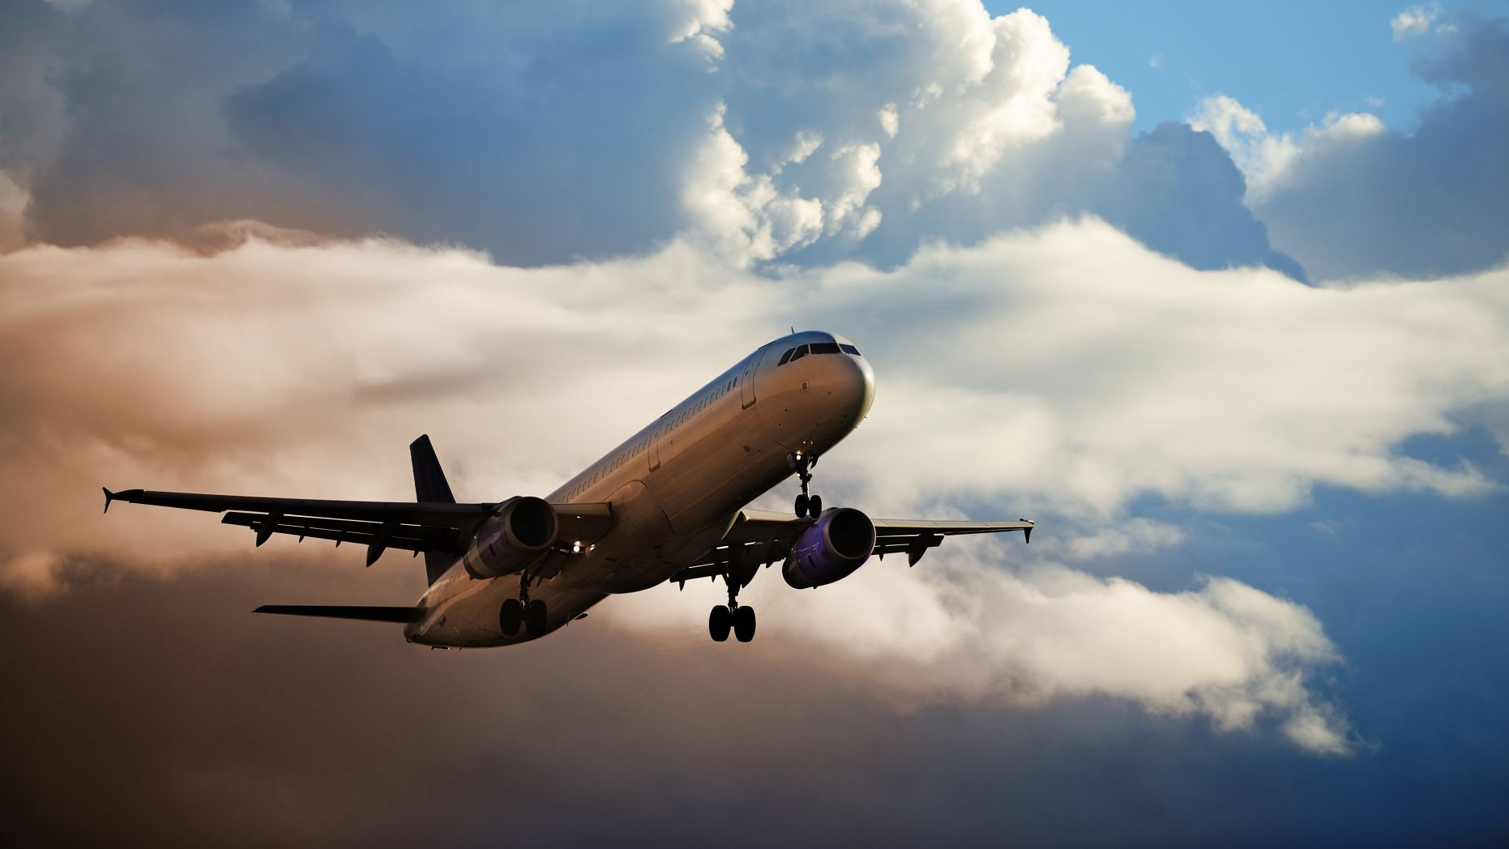
Airline Safety Final Presentation
By
Santosh Omprakash

Slide 2
Is Airways safest means of Transportation

Slide 3
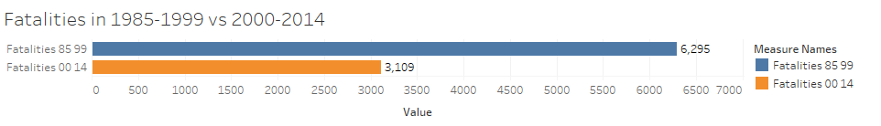

Slide 4
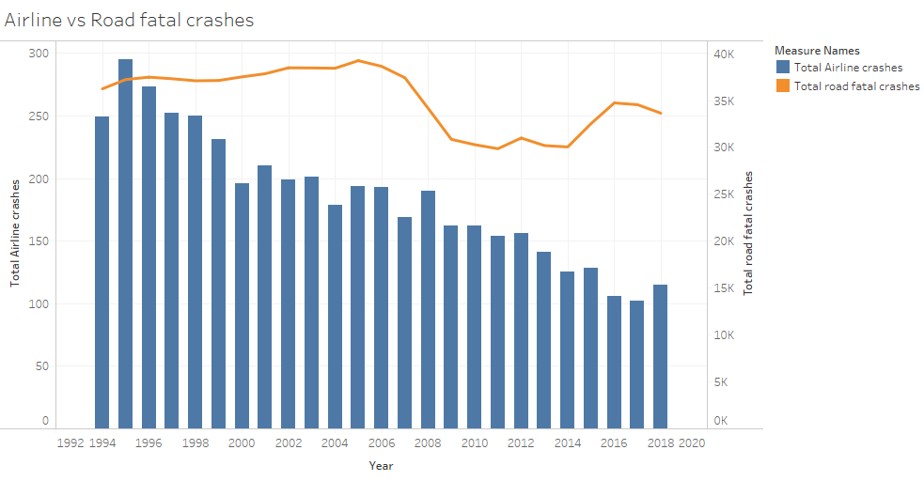

Slide 5
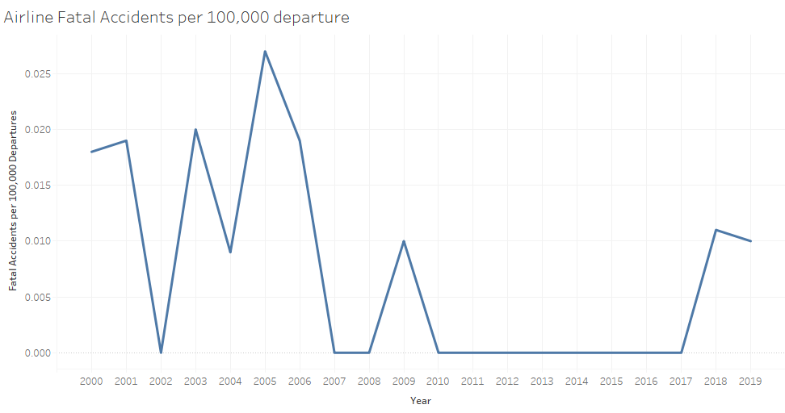

Slide 6
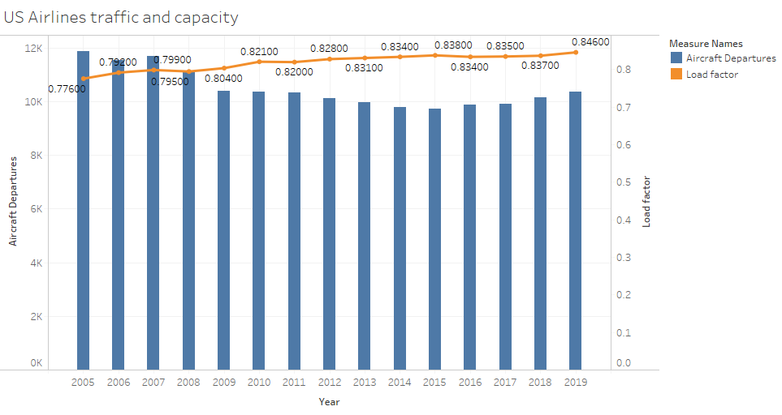

Slide 7
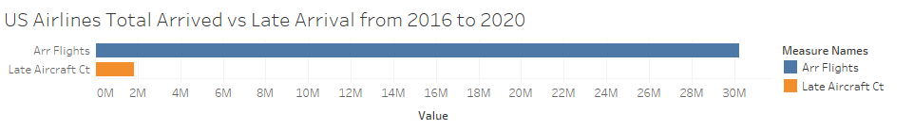
30.25M
1.84M

Slide 8
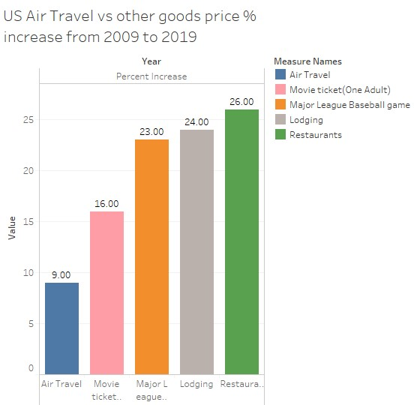

Slide 9
Is Airline Travel Safe?
Yes

